Slide 1
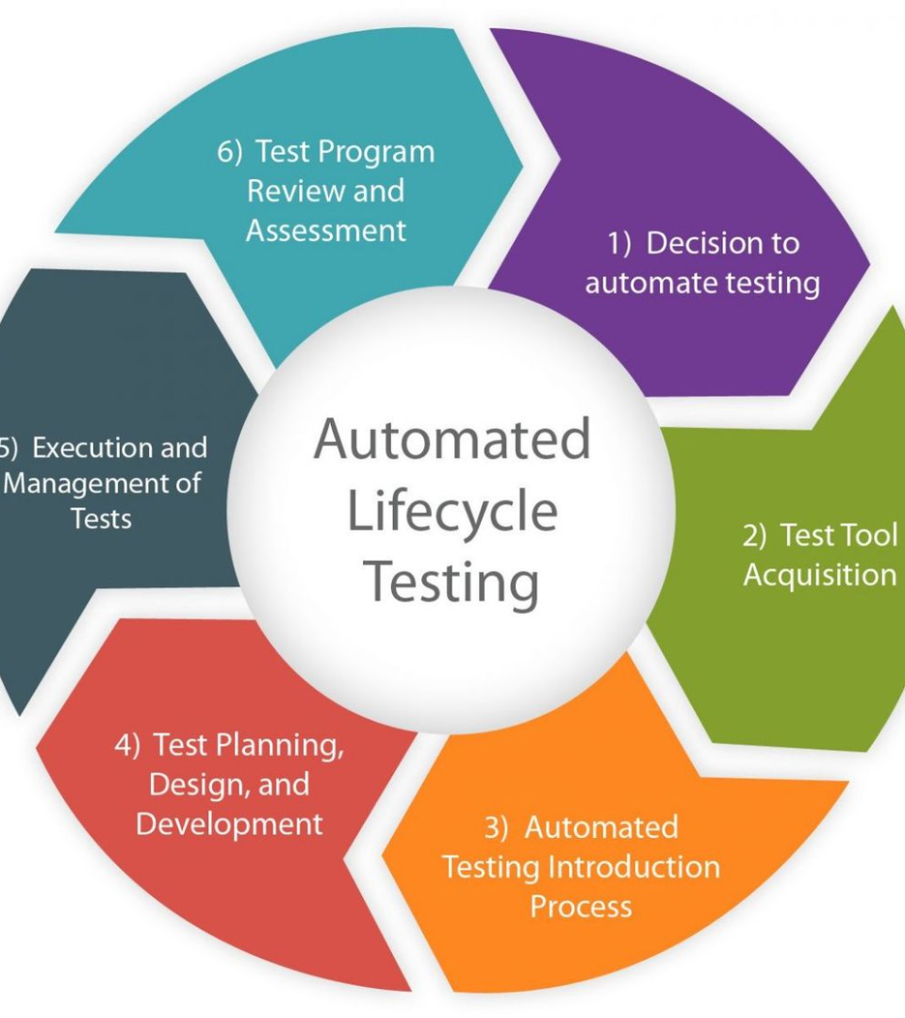

Automate Software Testing with Python
Software testing is crucial to ensure the quality of your applications. In this presentation, we will explore how Python can be used to automate software testing, saving time and improving efficiency.

Slide 2
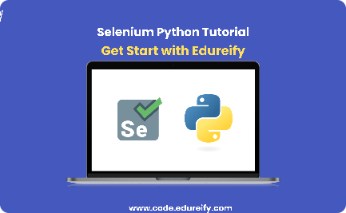
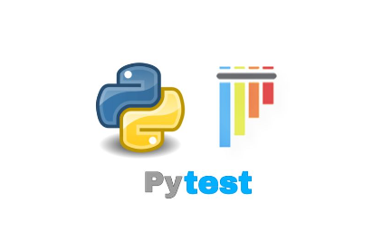
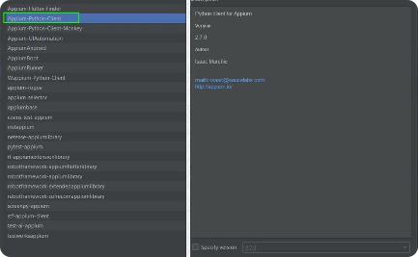
Common Tools and Frameworks for Automated Testing in Python
Selenium
Pytest
Appium
Selenium is a popular framework for web application testing, providing powerful capabilities for automating browser interactions.
Pytest is a Python testing framework that simplifies the process of writing and running tests by providing a concise and intuitive syntax.
Appium is widely used for mobile application testing, supporting both Android and iOS platforms using a single API.

Slide 3

Writing Automated Tests using Python
1
Test Planning
Define test requirements, scenarios, and objectives before designing and implementing the test scripts.
2
Test Script Creation
Write test scripts using Python, incorporating relevant libraries and frameworks to interact with the application under test.
3
Test Data Preparation
Generate or gather test data required to simulate real-world scenarios and cover different test cases.

Slide 4
Running and Analyzing Automated Tests
1
Execution
Run automated tests across various platforms, configurations, and test environments to validate application functionality.
Result Analysis
2
Analyze test results and generate reports, identifying failures, defects, and areas for improvement.
3
Bug Reporting
Report identified bugs and issues following standard procedures, ensuring efficient communication and collaboration with the development team.

Slide 5

Program:

Slide 6
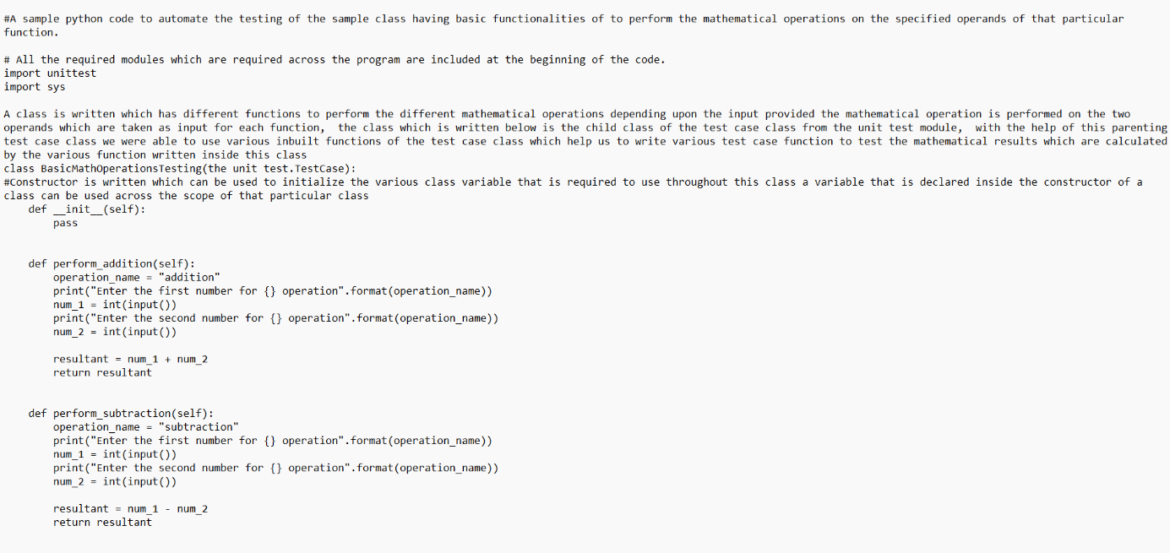

Slide 7
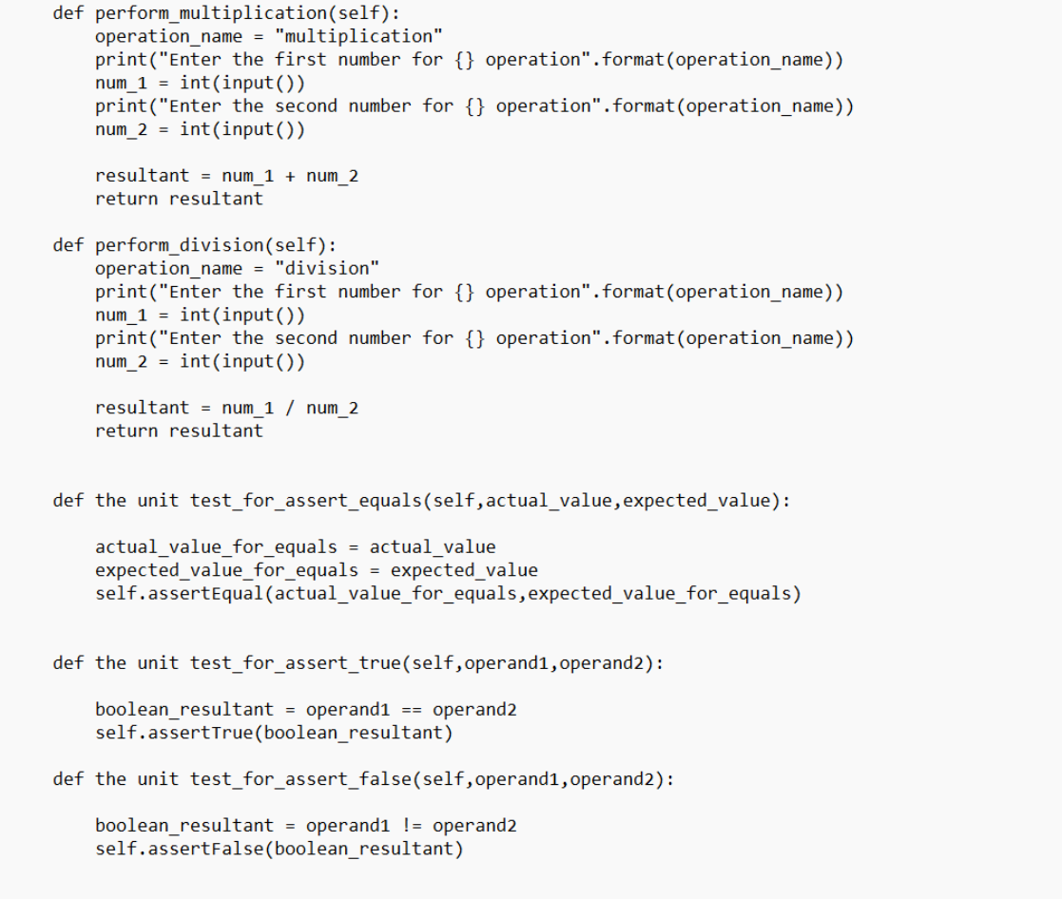

Slide 8
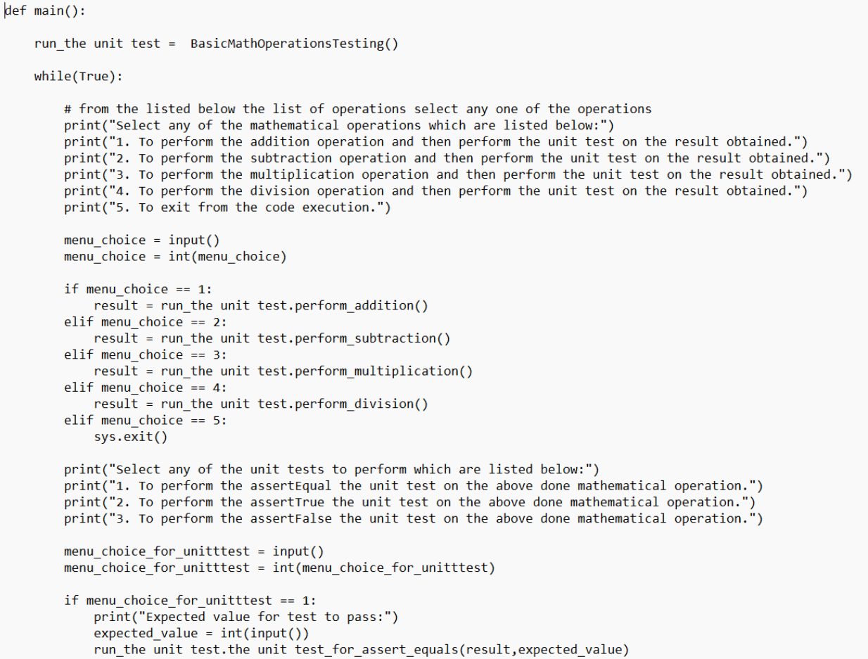

Slide 9
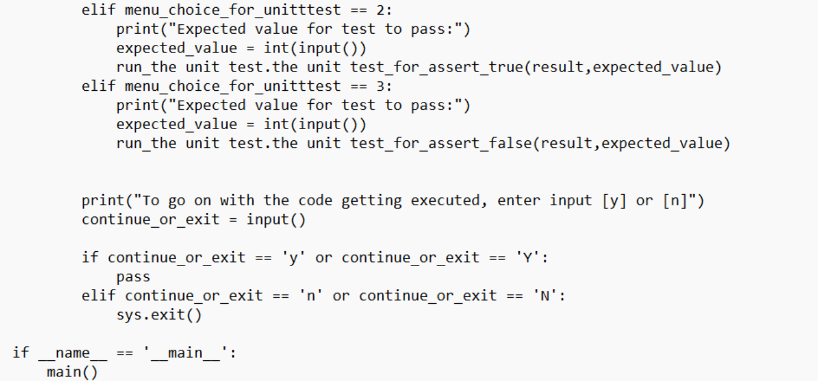

Slide 10
output

Slide 11
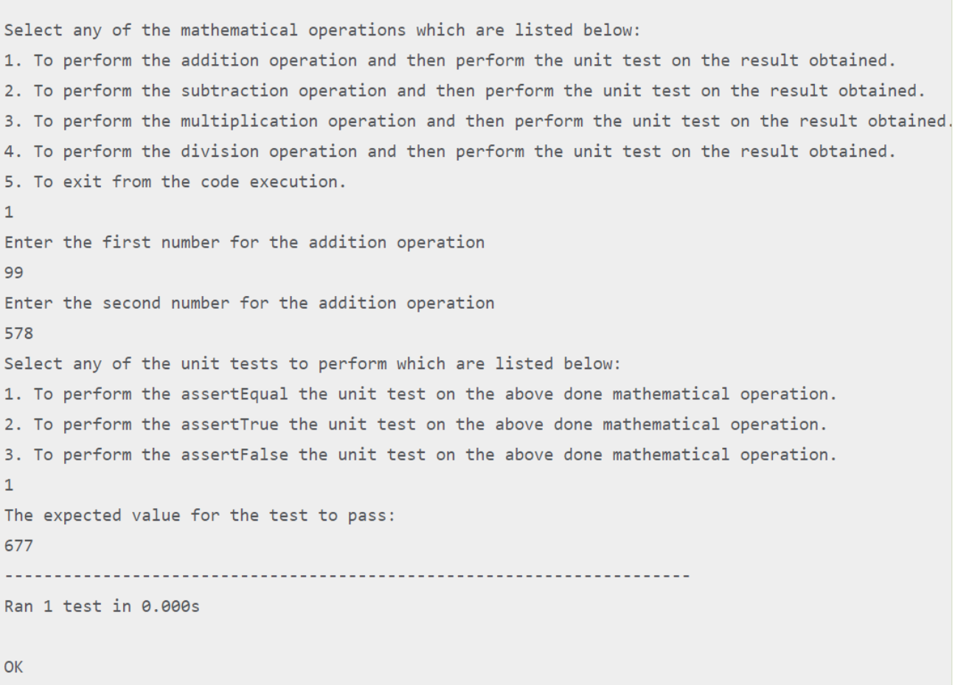

Slide 12
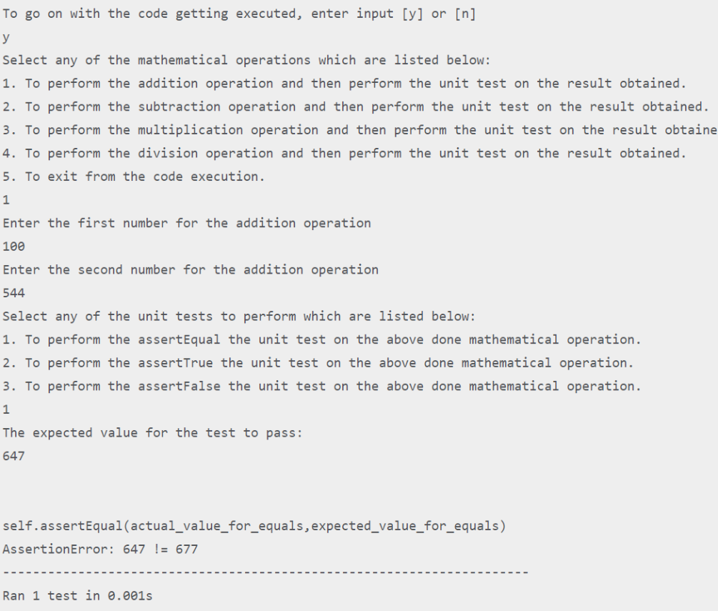

Slide 13
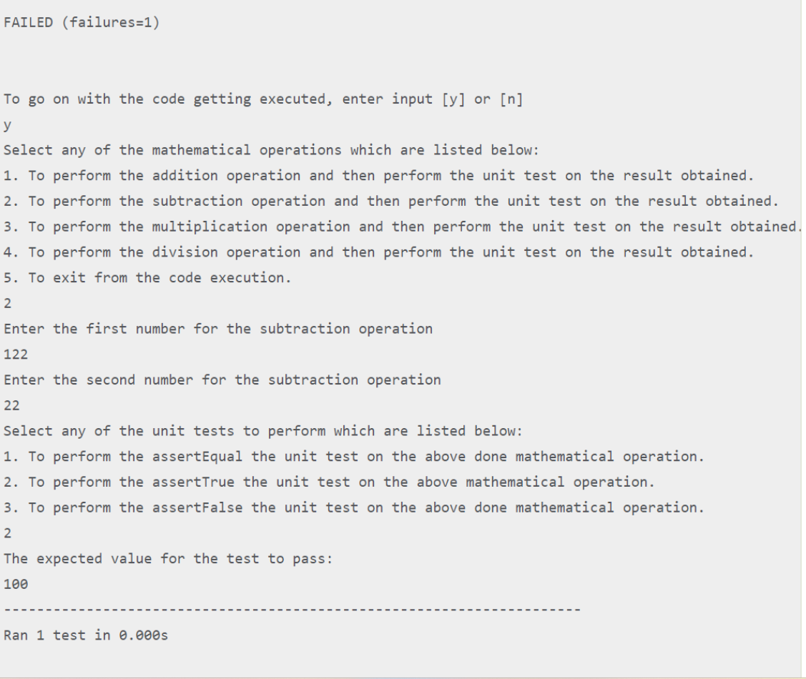

Slide 14
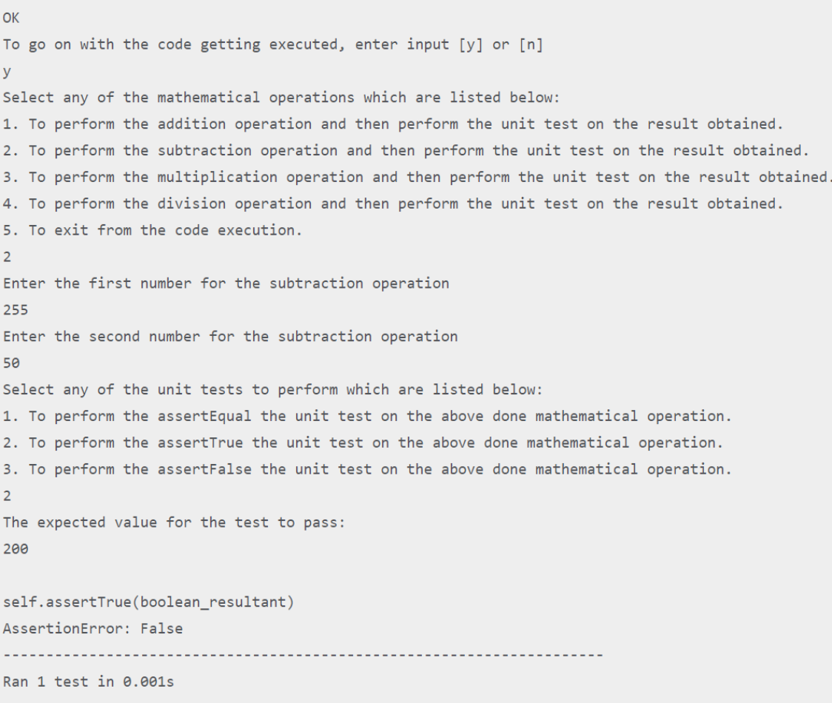

Slide 15
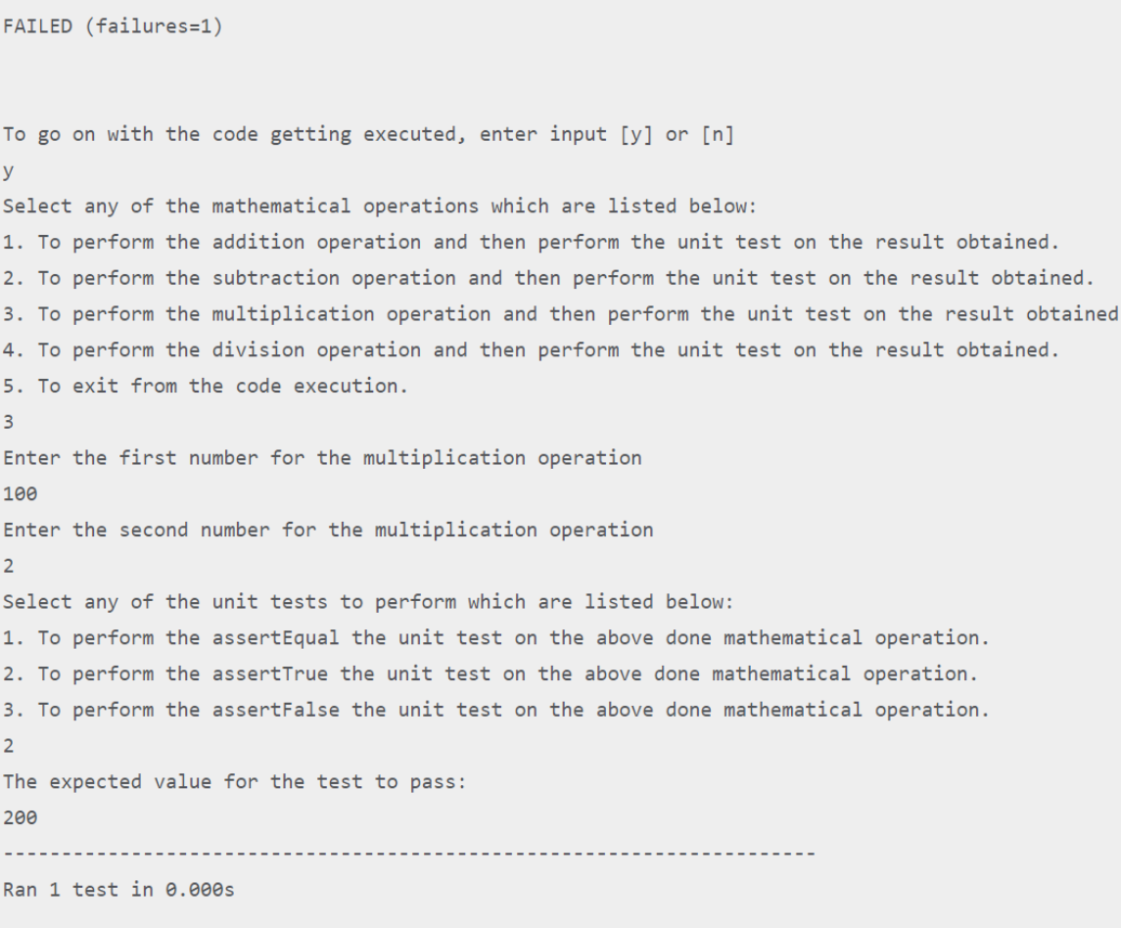

Slide 16
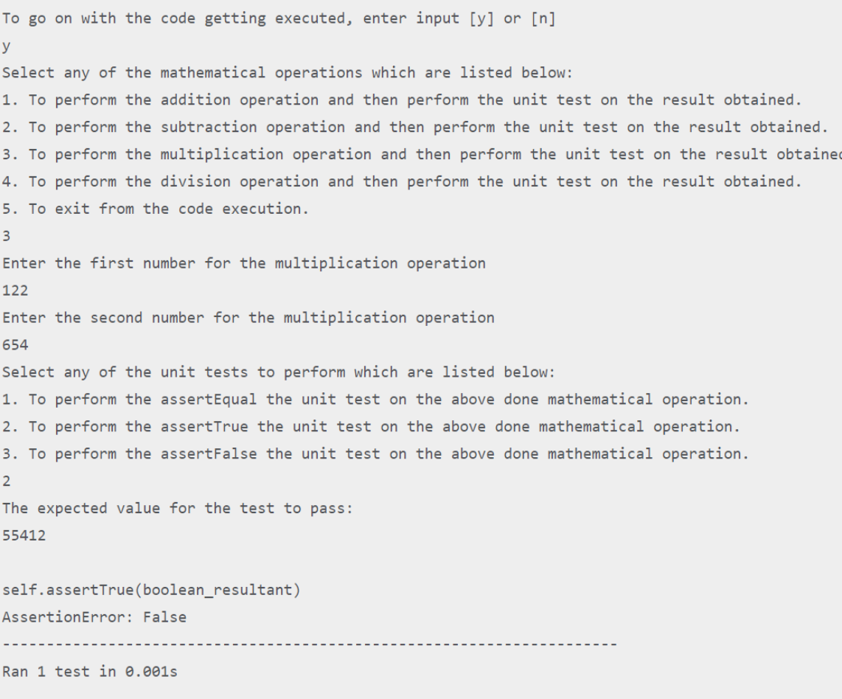

Slide 17
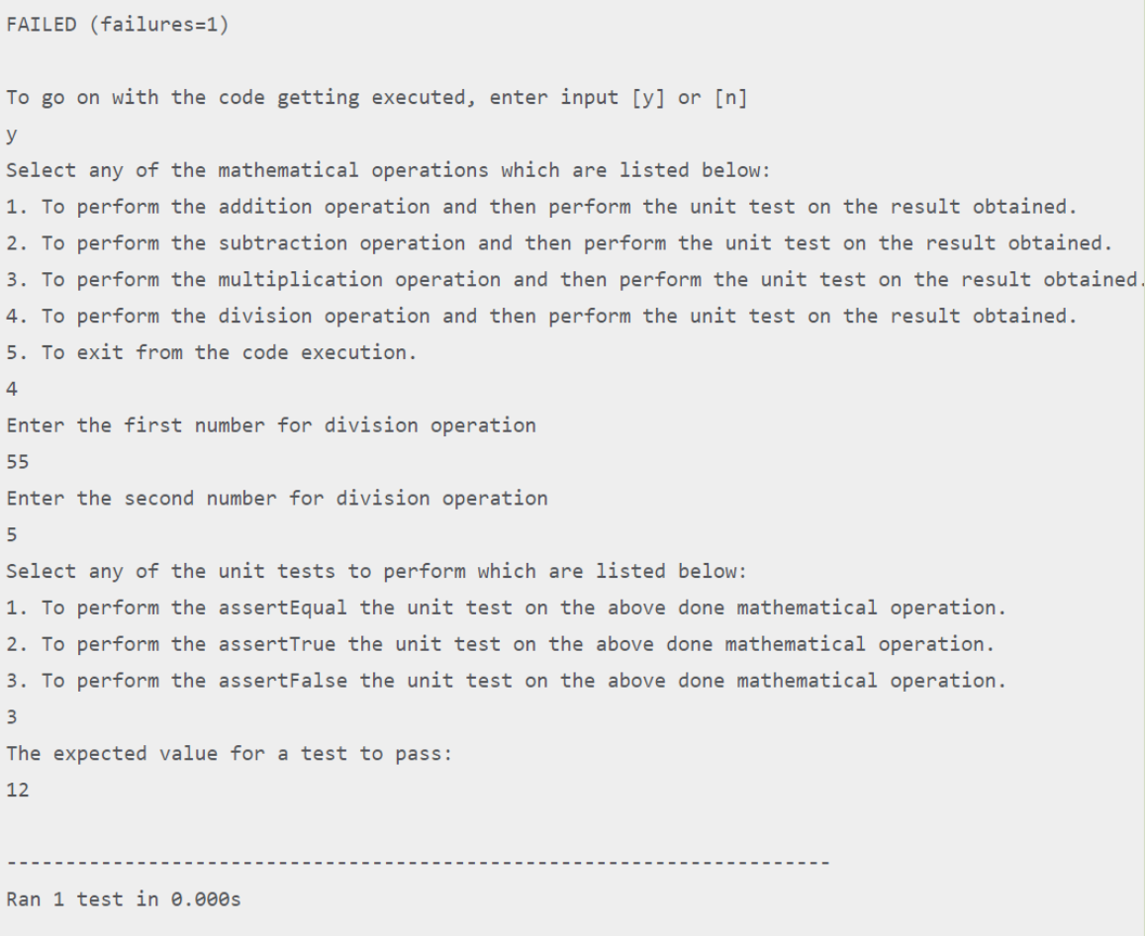

Slide 18
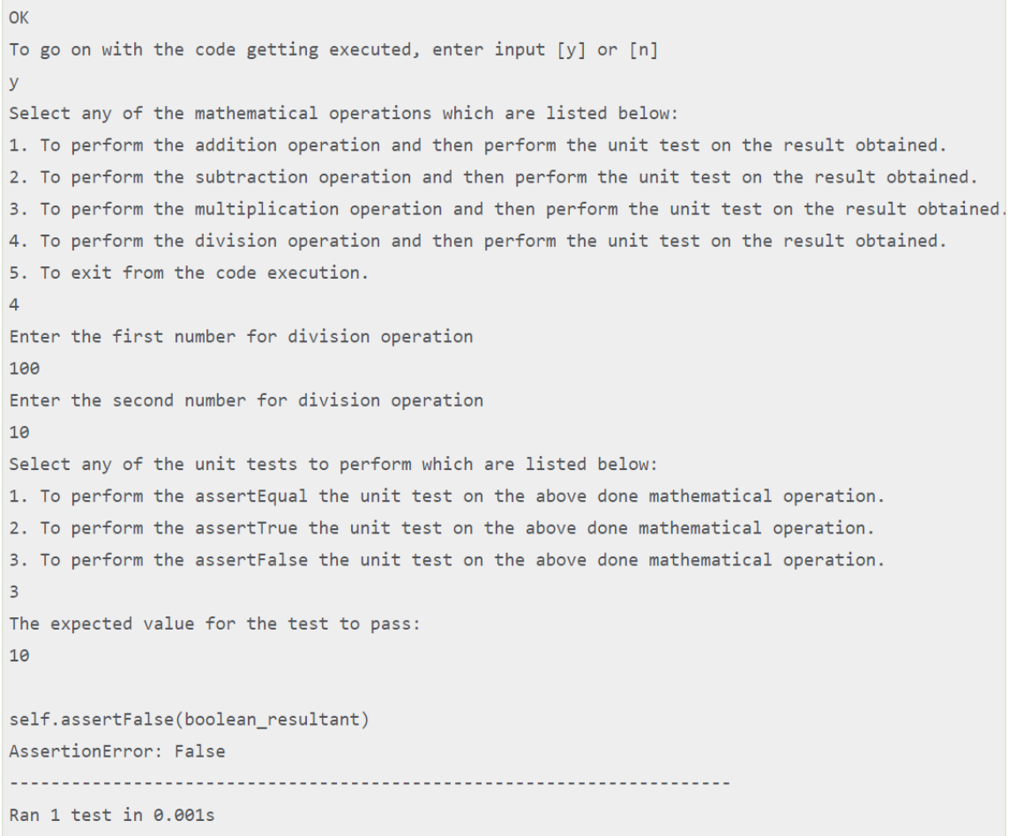

Slide 19
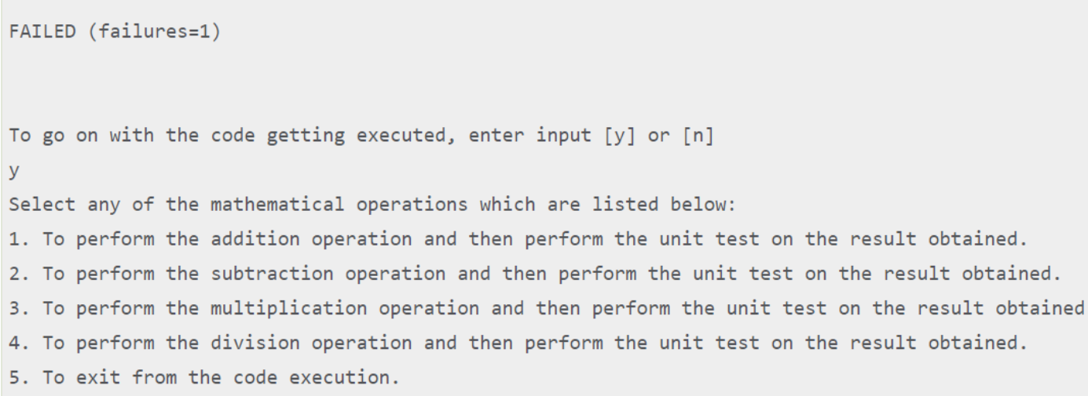

Slide 20
Best Practices for Automated Software Testing in Python
Modularity
Data-Driven Testing
Design test scripts that are modular and reusable, enabling easy maintenance and scalability of the test suite.
Utilize external data sources, such as CSV or Excel files, to validate test scenarios with different inputs and expected outputs.
Error Handling
Continuous Integration
Implement appropriate exception handling mechanisms to gracefully capture and handle errors encountered during test execution.
Integrate automated testing into the software development lifecycle, leveraging tools like Jenkins or GitLab CI/CD for seamless integration and execution.

